Slide 1
PROBLEM STATEMENT
13.VEHICLE MOVEMENT ANALYSIS AND INSIDE GENERATION IN COLLEGE CAMPUS USING EDGE AI

Slide 2
Unique Idea Brief (Solution)
Problem Statement:
Lack of real-time vehicle monitoring.
Inefficient parking and traffic management.
Limited security insights and high manual surveillance dependency.
Proposed Solution:
Edge AI Deployment:
Use AI-enabled cameras and sensors at key locations.
Process data locally on Edge devices for minimal latency.
Data Analysis:
Collect and analyze vehicle entry/exit times, parking duration, and movement patterns.
Insight Generation:
Provide insights on peak traffic times, parking usage, and detect suspicious activity.
Send real-time alerts to campus security and management.

Slide 3
FEATURES OFFERED
Real-time License Plate Recognition (LPR):
Capture and recognize license plates of vehicles entering and exiting the campus in real-time, ensuring instant identification and logging.
Automated Entry/Exit Logging:
Maintain detailed logs of vehicle entry and exit times based on license plate detection, streamlining security and administrative tracking.

Slide 4
Traffic Flow Analysis:
Analyze vehicle movement patterns to identify peak traffic times and congested areas, enabling optimized traffic management and infrastructure planning.
Security and Access Control:
Use license plate recognition to detect unauthorized vehicles, enhancing campus security and controlling access to restricted areas.
Parking Management:
Track vehicle parking duration and occupancy, improving space utilization and ensuring efficient management of parking resources.

Slide 5
PROCESS FLOW

Slide 6
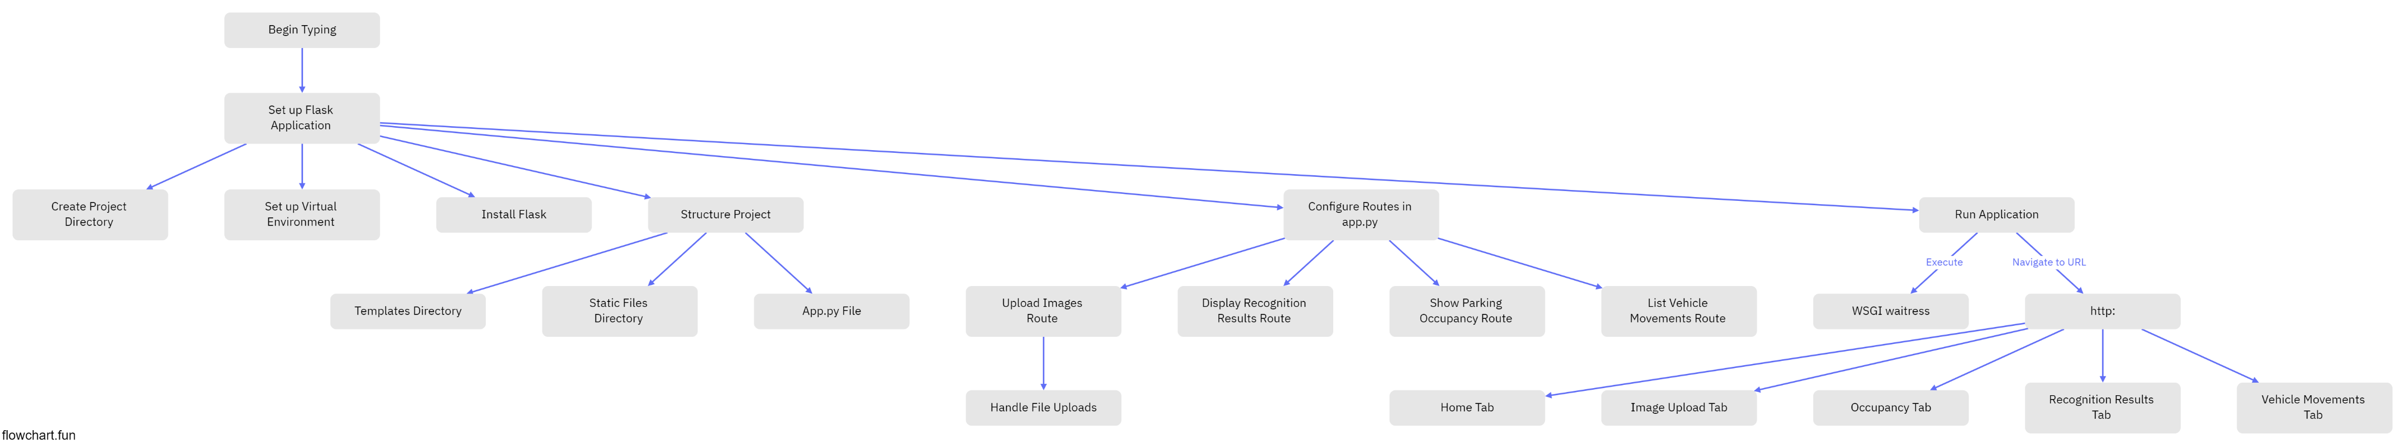
PROCESS FLOW

Slide 7
ARCHITECTURE DIAGRAM

Slide 8
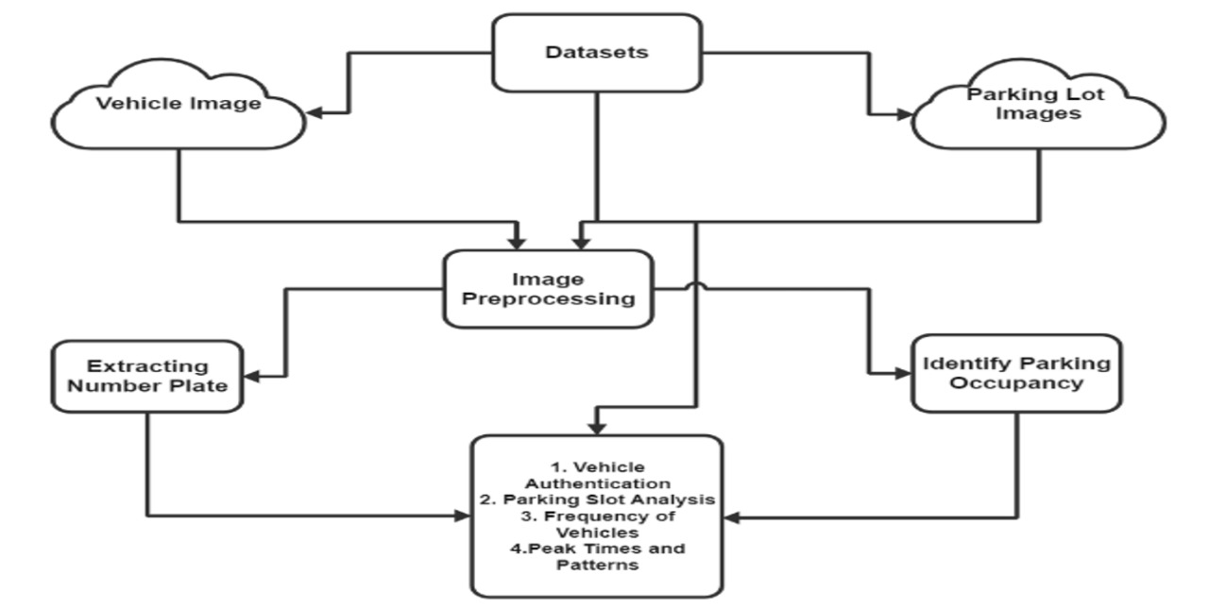

Slide 9
TECHNOLOGIES USED
Python:
Description: A high-level, interpreted programming language known for its simplicity and readability.
Usage: Python is used for developing the main application logic, integrating AI models, and processing data from cameras and sensors.
Flask:
Description: A lightweight web framework for Python that is easy to set up and use.
Usage: Flask is used to create the web server for the application, providing routes and handling requests for vehicle movement data and insights.

Slide 10
WSGI (Web Server Gateway Interface):
Description: A specification for a universal interface between web servers and web applications or frameworks for the Python programming language.
Usage: WSGI allows for a standard way of communicating between the web server (Waitress) and the Flask application, ensuring compatibility and performance.
Waitress:
Description: A production-quality pure-Python WSGI server with very acceptable performance.
Usage: Waitress is used to serve the Flask application, ensuring it can handle multiple requests efficiently and reliably in a production environment.
WSGI (Waitress) serves as a robust and efficient WSGI server, ensuring reliable performance and secure deployment of Python web applications.

Slide 11
TEAM MEMBERS
S.Sameera Tasneem – BU21EECE0100100
Sarai Sai Lohitha –BU21EECE0100103
Ramireddy Indumathi – BU21EECE0100360

Slide 12
CONCLUSION
This Edge AI-driven solution for monitoring vehicle movement and parking represents a significant leap forward in campus management. Using real-time image processing and data analysis, the system delivers crucial insights into:
1. Patterns of Vehicle Movements
2. Occupancy Levels in Parking Areas
3. Vehicle Identification and Matching

